Slide 1
How To Be A Healthy Programmer
“Programming is one of the worst things you can do for your physical health”
By Luna Lunapiena

Slide 2
Advisory
Some of the topics this conversation includes:
Eating
Weight Loss
Dieting
Exercise
Please Feel Free to Step Out at Anytime!!

Slide 3
Health Is Complicated
The Information about it is enormous & often conflicting
So Let’s Clarify…

Slide 4
A Healthy Person
A Healthy Person is:
At low risk for developing lifestyle-induced diseases
Relatively pain free

Slide 5
Unit-Testing Your Health
I lose my breath after climbing 1 flight of 1 stairs
I regularly sit for more than 1 hr. without getting up
Back, Neck, Shoulder or Wrist pain intereferes with my job

Slide 6
Unit Testing Your Health
My eyes become dry, red, irritated or difficult to focus after looking at a computer screen
I eat uncomfortably until I’m Full
I’m exposed to Direct Sunlight less than 10 minutes a day

Slide 7
Programming
PROGRAMMING IS ONE OF THE WORST THINGS YOU CAN DO FOR YOUR PHYSICAL HEALTH

Slide 8
Reprogramming Your Habits
Identify Cue:
Where are you?
What time is it?
How are you feeling?
Who’s with you?
What action preceded the urge?

Slide 9
Identify The Reward
The Reward for buying a candy bar might seem obvious, but it might actually be:
The walk to the vending machine
Getting your blood flowing
Being social

Slide 10
Storytime
I chose my college advisor because of Jelly Beans
Every day I’d come into their office to get Jelly Beans
We started having deep conversations about Music & Theory
I’d come back every day ostensibly to have more Jelly Beans
(Let’s face it they’re Yummy)
Really I was coming back for the connection
Eventually I picked this person as my advisor
All because of some Jelly Beans!!!

Slide 11
Plan Your New Routine
Keep the following on a sticky:
When Cue:
I will ROUTINE
In order to get REWARD

Slide 12
One Step At A Time
Be Iterative
Don’t Overwhelm yourself by trying to change too much simultaneously
Use a Program to Track Your Progress
Recommended: HabitRPG

Slide 13
Walking
One of the best ways to Enhance your learning is Exercise
Brain Derived Neurotropic Factor (BDNF) enhances connections between Neurons
Many famous thinkers and writers Walked Constantly
Your ability to think, remember & concentrate will be enhanced as blood returns to your brain
Ready for the Fun Part??

Slide 14
Take A Walk
Stop Everything
Stand Up
Walk Around Room for 1 minute
At the end of 1 minute, I’ll call you back to your seats

Slide 15
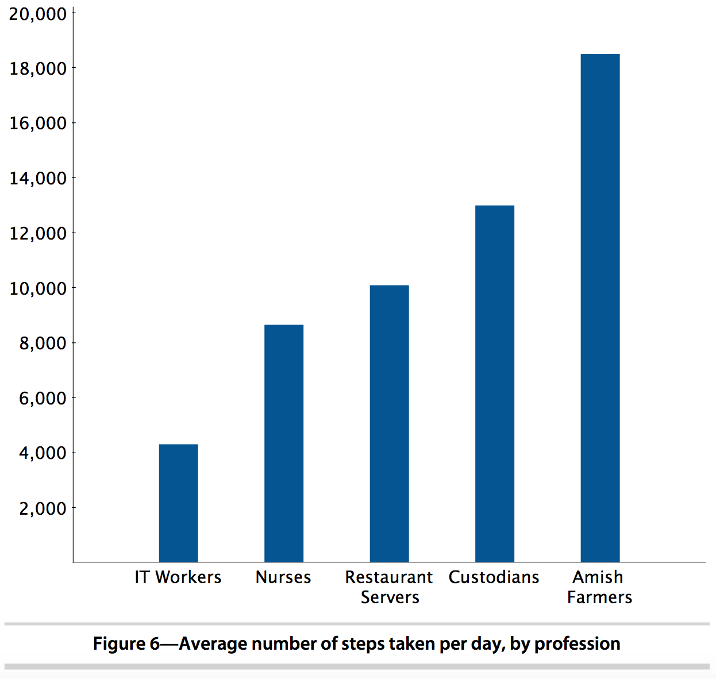
And I Would Walk 500 Miles

Slide 16
Walking – How To Succeed
BUY A PEDOMETER
10,000 steps per day = Minimum
CDC says do this in 3 blocks of 3,000 & 1 block of 1,000

Slide 17
Sitting
Sitting is BAD for you
Studies correlate 11-50% Mortality Risk Increase from All Mortality Causes
Exercises to Counter Bad Effects of Sitting:
Leg Circle
Lower Leg Lift
Knee Lift
Overhead Clap

Slide 18
Standing Desks
Are only good if used in Moderation
Do Not Use Standing Desks if you have:
High Blood Pressure
High Cholesterol
Diabetes
Fine Motor Skills Decrease while standing
Search Amazon for Desk Convertors

Slide 19
Sitting & Standing
Adjust between Sitting & Standing in 20 minute intervals
(This seems a bit extreme…)
If it Hurts, change
Walk when you can!
Make sure your Shoes have Arch Support!!!
Balance Boards may help counteract Negative FX of Standing

Slide 20
Agile Dieting
Try different Diet Formats to start – just observe
(This seems like a bit of an extend process…)
Guiding Principles:
Individual tastes over predefined menus
Balanced nutrition over idiosyncratic diets
Counting calories over following trends
Responding to your environment over sticking to a diet plan

Slide 21
Nutritional Needs
Most Health Organizations Recommend:
30% Fruits & Vegetables
16% Lean Protein (Meat, Fish, Eggs, Beans)
16% Milk & Dairy
8% Fatty & Sugary Foods

Slide 22
Eat Because You’re Hungry
Make sure to eat b/c you’re hungry – not because Food was there as a reward
Exercise:
Write down everything you Ate today
Ask yourself: “Did I eat this because I was hungry? Or did I eat it because it was there?”

Slide 23
Counting Calories
Cutting just 100 Calories/Day can have very profound effects
Adding 400 Calories is enough to add 2 lbs of Body Weight every 3 weeks
Easiest Approach to this is to use the app MyFitnessPal
You’ll also learn a ton about the Nutritional Composition of the food you’re eating

Slide 24
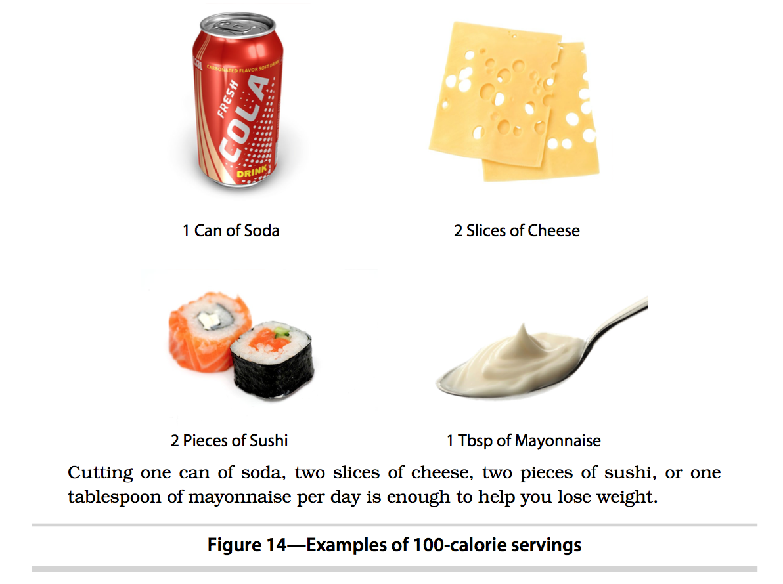
Calorie Examples – 100 Cals

Slide 25
Diet Rules
Diet = Plan for Long-Term Healthy Eating
Experiment & Iterate
Ex: Try eating Half your meal … if you’re still hungry 30 min later, make modifications to the next meal
(This seems a bit extreme)
Eat Foods that Satisfy your
Avoid Fatty, Greasy, Salty, Sugary – you’ll be hungry again
Eat foods that fill you & keep you satisfied
Protein is most satisfying

Slide 26
Diet Rules
Schedule your eating:
Proper Meal Portion satisfies for 4 hrs
Sugary Snack satisfies for 1 hr
Schedule based on this; Don’t eat if it’s not time to eat
Write a List of Off-Limit Foods:
Writing A List will help you follow your rules
Don’t restrict foods that you LOVE. Just eat in moderation

Slide 27
Rehearse Your Diet
Think about the Cues that will cause you to stray from your diet
Think about what they feel like
Practice what you’ll do to respond to them & avoid the Bad Routines

Slide 28
Vision
Computer Vision Syndrome:
Results from prolonged focus on Computer Screen
Symptoms: Headaches, Dry Eyes, Irritated Eyes, Redness in Eyes, Blurred Vision, Neck Pain, Fatigue, Double Vision, Difficulty Refocusing Eyes
AKA: LIFE!!!
To Fix:
Blink Often
Exercise Eyes: Every 20 min, look at something 20 min away

Slide 29
Vision
Remove Prescription Glasses if you don’t need them to see computer screen
Eye Doctors recommend you were them as little as possible
Unit Test Your Vision:
Go to Eye Doctor
Use an App that tests your vision

Slide 30
Monitors
Position Monitor 20-40 in. away
Brightness
Match Room
If you hold a book against screen & it becomes illuminated as you bring it closer, then your monitor is too bright (Or Room is too dark)
Glare:
Relax Your Eyes
Reds/Blues:
Blue Light can be damaging to your Retina
Reduce Display’s Color Temperatures
Use F.lux!!!

